Slide 1
Capstone Design
Team 3
20163704
20161344
20164245
Park JuHyeon
Heo JeongWoo
Hong Jin

Slide 2
Contents
1.
Project Introduction
Progress
Demo
Q&A
2.
3.
4.

Slide 3
1.
Project Introduction

Slide 4

1
Project Introduction
Project Title
Smoothie
“Smoothie” is a Photo Edit Program,
We select this project’s title to emphasize feeling of ‘Smooth’.

Slide 5
1
Project Introduction
Team name & Members
Team 3 – 316
Team Members – Park JuHyeon, Heo JeongWoo, Hong Jin
Three people whose student numbers are 16.

Slide 6


1
Project Introduction
Topic
Model
person
Input
Output

Slide 7

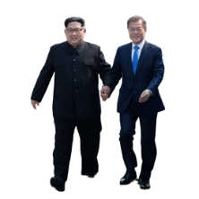

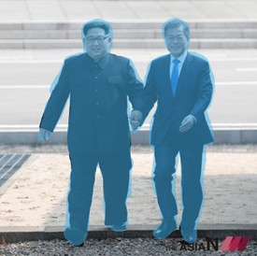
1
Project Introduction
Scenario
file
example 1
example 2
person
Main
Sub

Slide 8
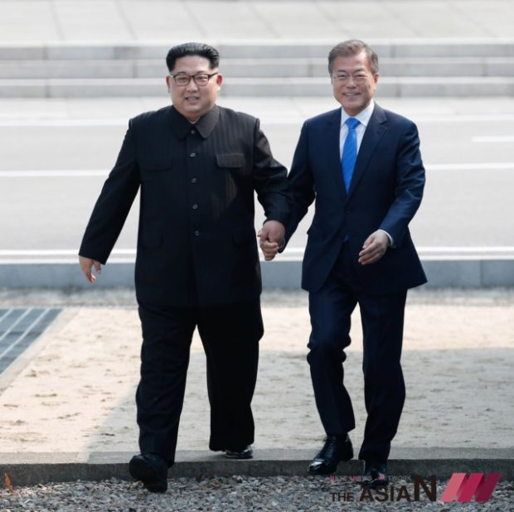

1
Project Introduction
Scenario
file
example 1
example 2
person
drag
Main
Sub

Slide 9
1
Project Introduction
Scenario
file
example 1
example 2
person
Main
Sub

Slide 10
2.
Progress

Slide 11
2
Schedule
 | March |  |  | April |  |  |  |  | May |  |  |  | June
Week | 11 | 18 | 25 | 1 | 8 | 15 | 22 | 29 | 6 | 13 | 20 | 27 | 3 | 10 | 17
Data survey
Collect Datasets
Detection Model
Segmentation Model
Lasso Function
QT basic UI
Prepare Midterm Demo
Function & QT Details
Test and Debugging
Prepare Final Demo
Writing manuals, report
Midterm Presentation
Final Presentation

Slide 12
2.1
QT

Slide 13
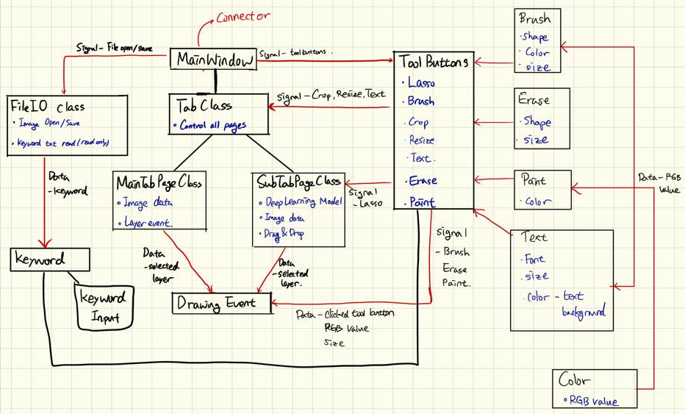
2
Progress
QT

Slide 14
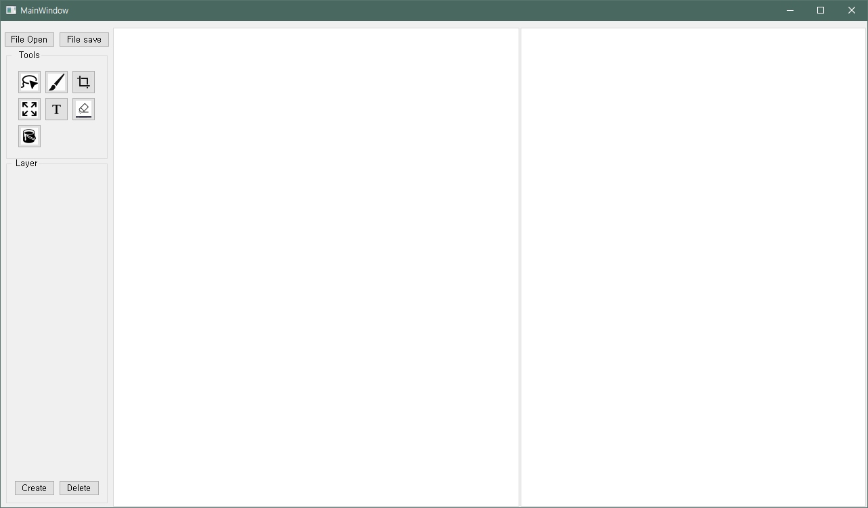
2
Progress
QT
Simple UI

Slide 15
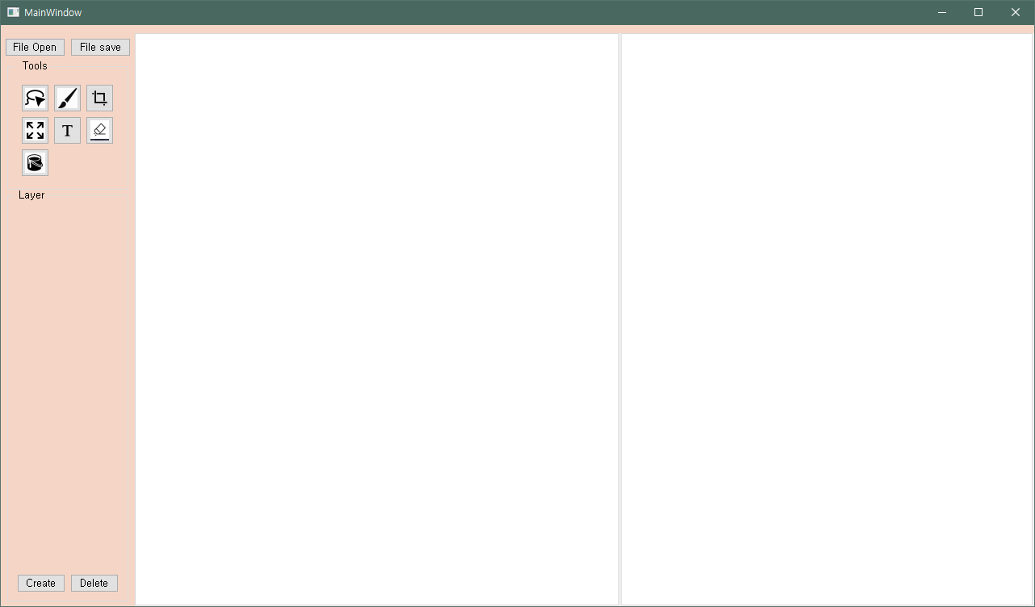
2
Progress
QT
Apply CSS Code
background-color:#F5D6C6;

Slide 16
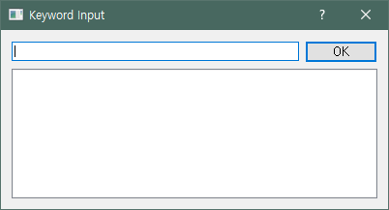
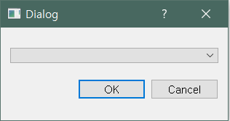
2
Progress
QT
Lasso Tool

Slide 17
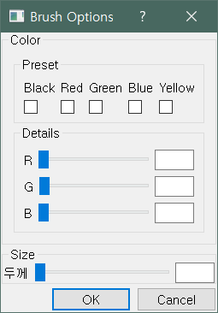
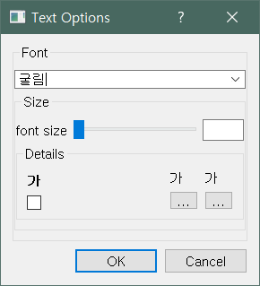
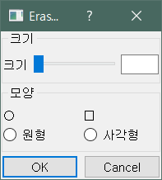
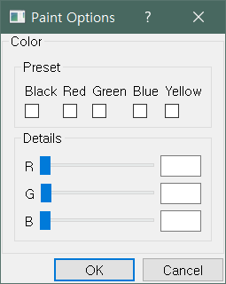
2
Progress
QT
Brush tool
Text tool
Eraser tool
Paint tool

Slide 18
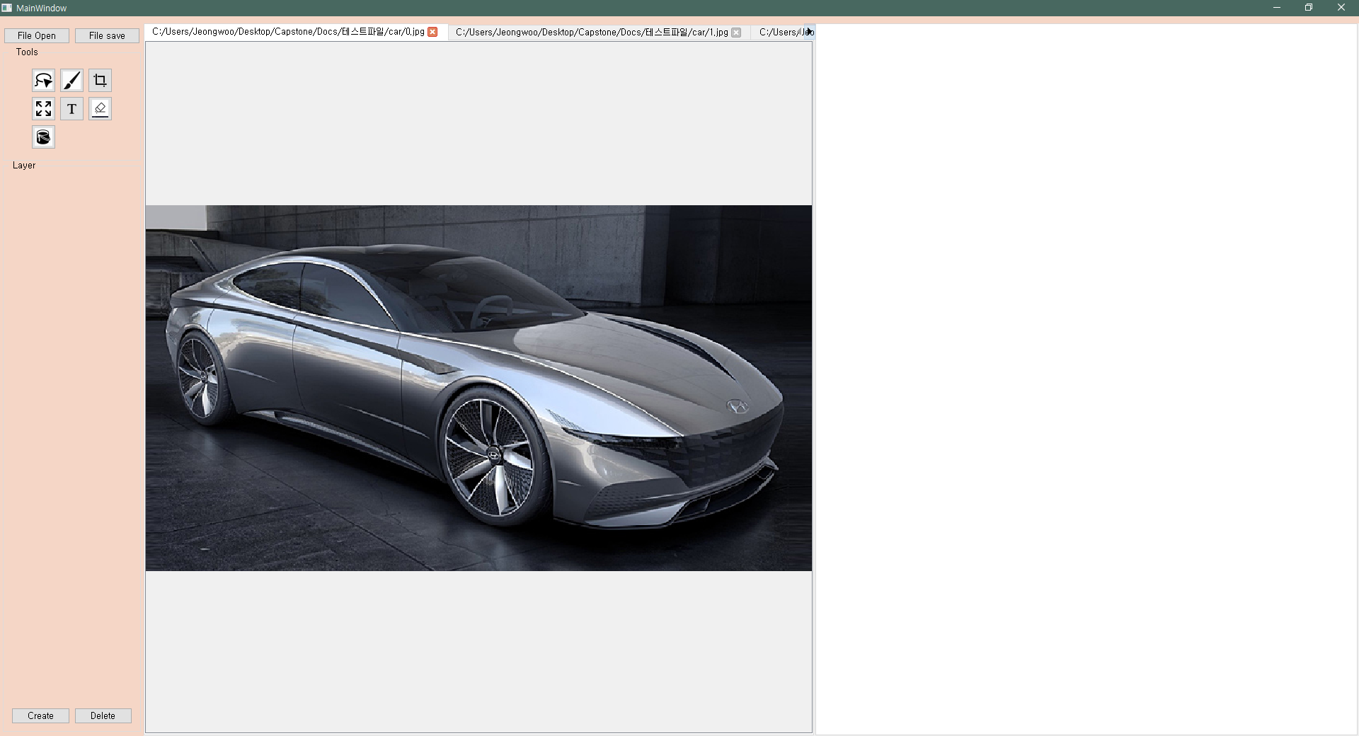
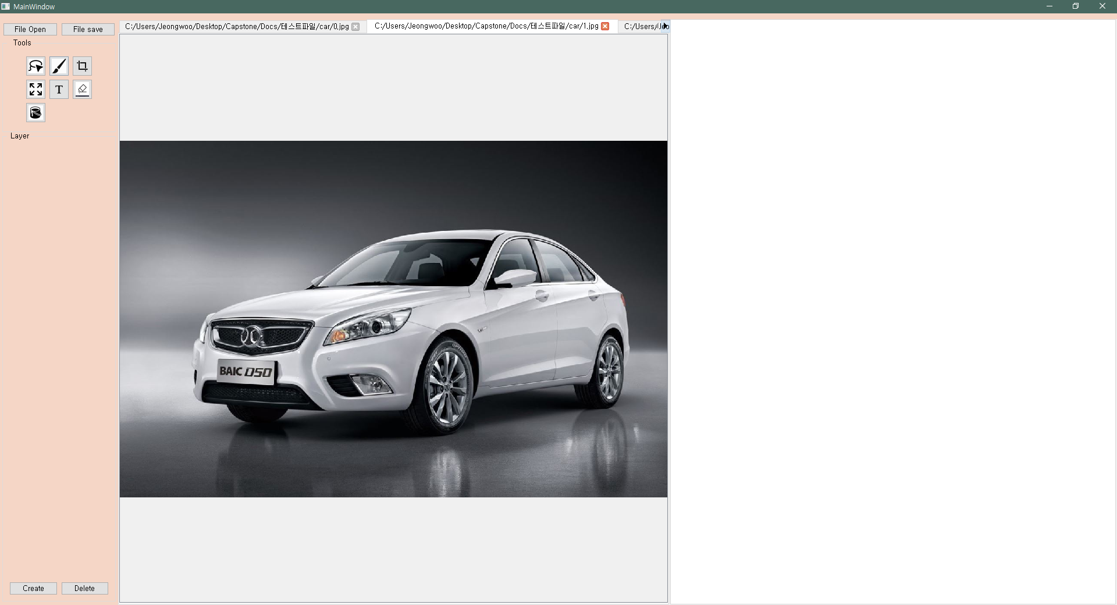
2
Progress
QT
File Open

Slide 19
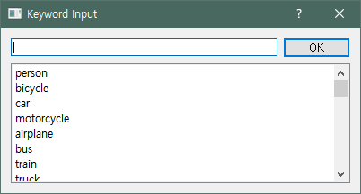
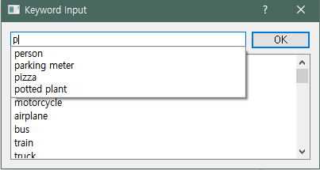
2
Progress
QT
Keyword Recommendation

Slide 20
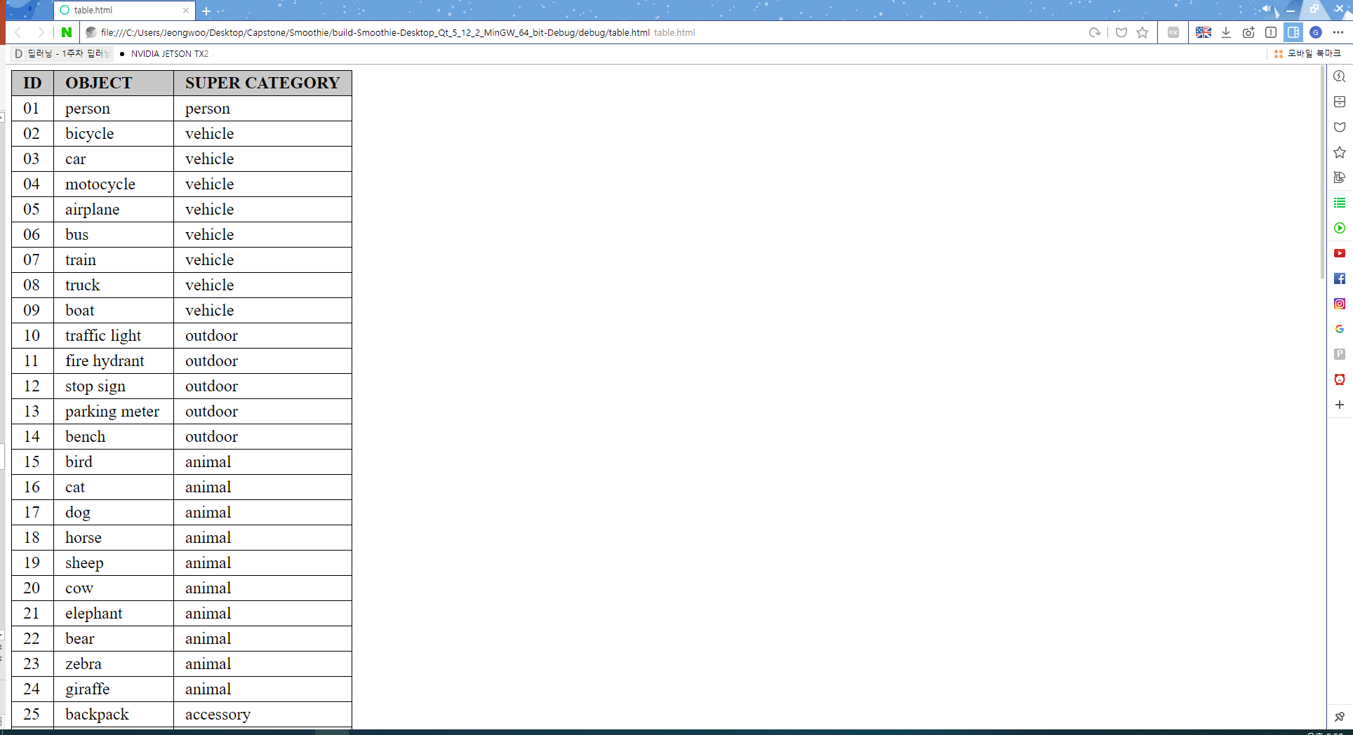
2
Progress
QT
Keyword Recommendation
click

Slide 21
2.2
Learning Model

Slide 22

2
Progress
Learning Model
Trained Data: MS-COCO 2017

Slide 23
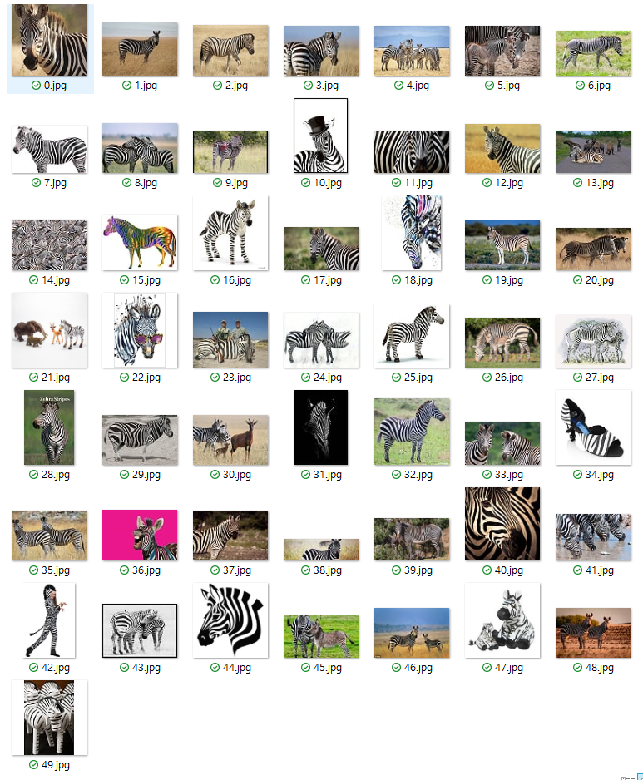
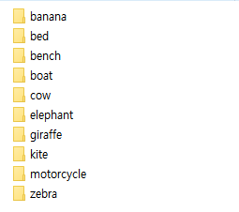
2
Progress
Learning Model
1. Test Image
40 categories, 2000 images

Slide 24
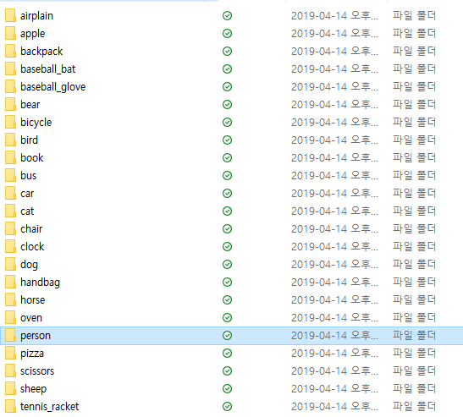
2
Progress
Learning Model
2. Test Result

Slide 25
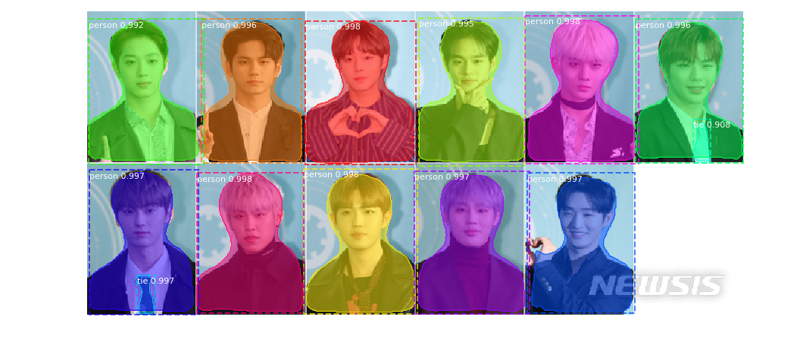
2
Progress
Learning Model
1. person

Slide 26
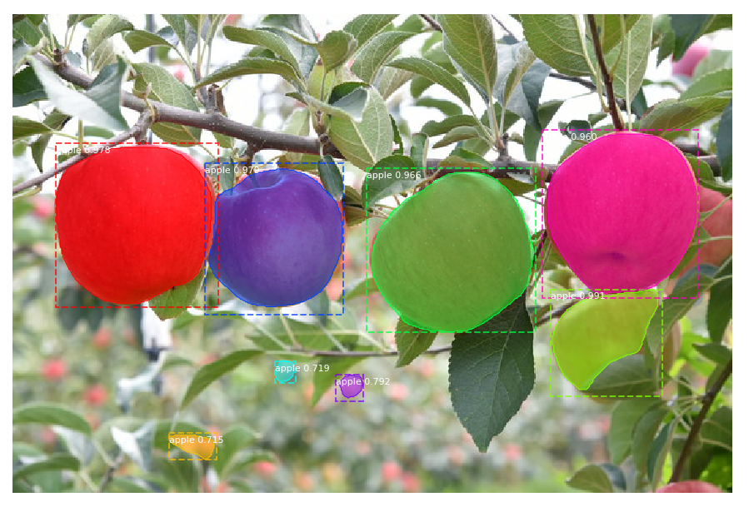
2
Progress
Learning Model
2. apple

Slide 27
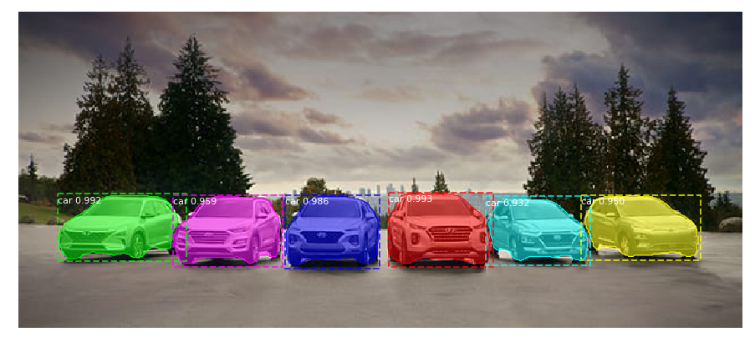
2
Progress
Learning Model
3. car

Slide 28
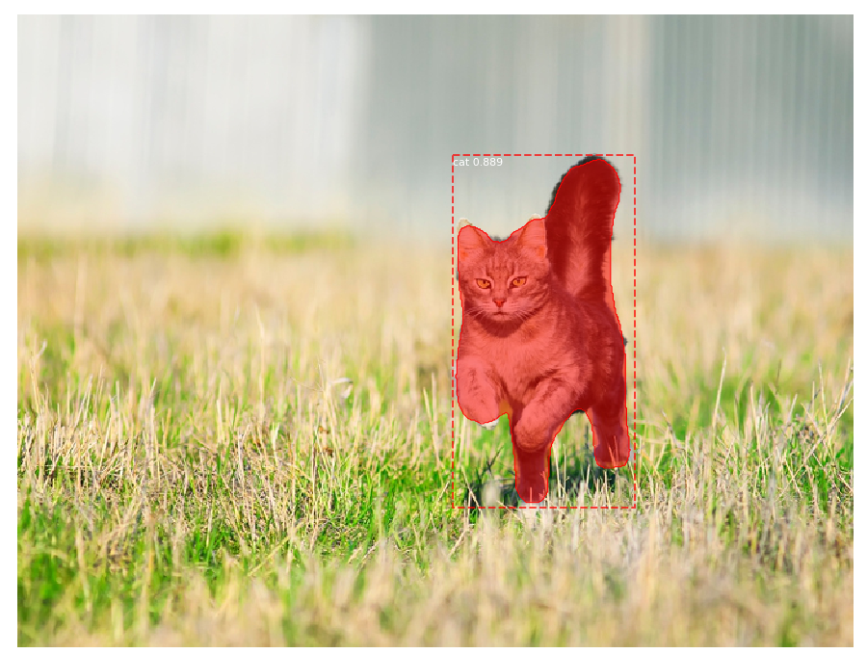
2
Progress
Learning Model
4. cat

Slide 29
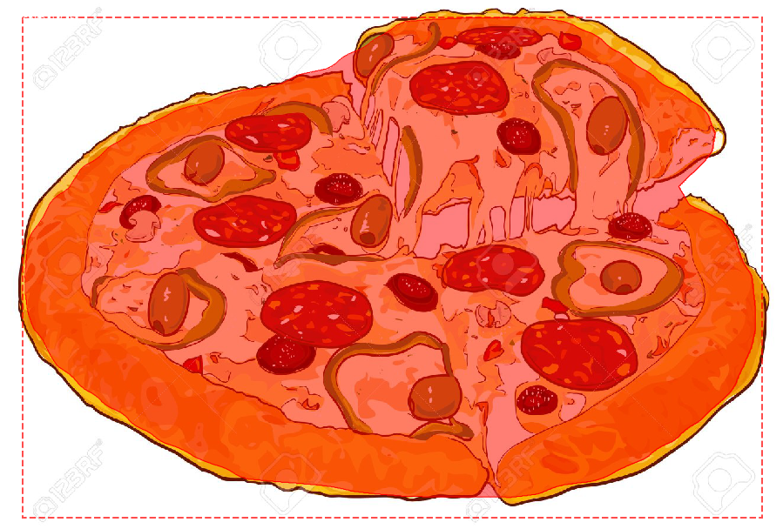
2
Progress
Learning Model
5. pizza

Slide 30
3.
Demo

Slide 31
4.
Q&A

